Slide 1

AIML CA1
PART A: Predicting Factory Machine Status

Slide 2
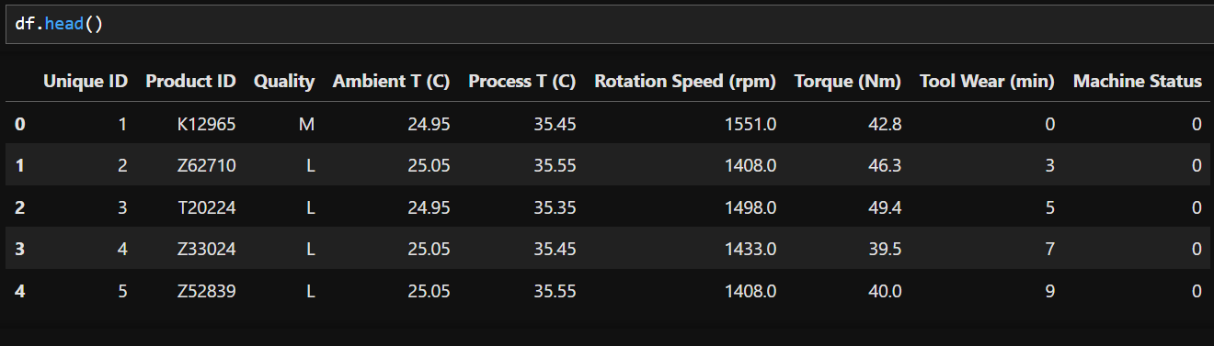
Data Exploration
After loading the data, I did df.head() to see what the first few rows of values look like. Quality is categorical and the rest of the data besides Unique ID and Product ID as they are irrelevant, are numeric values

Slide 3
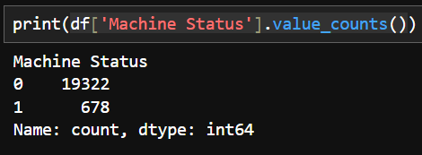
Data Exploration
Next, I checked the data type of the target variable, Machine Status and the distribution of the values. Using df['Machine Status'].value_counts(), we can see that the target is a binary value where 0 is normal and 1 is abnormal. Since the data is discrete, this will be a classification task.

Slide 4
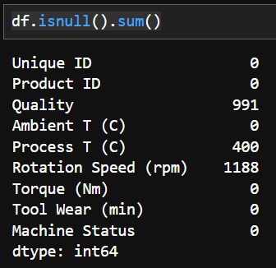
Data Exploration
Finally, I used df.isnull().sum() to see if there was any missing values and the amount. We can see that Quality, Process T, and Rotation Speed have missing values while the rest don’t.

Slide 5
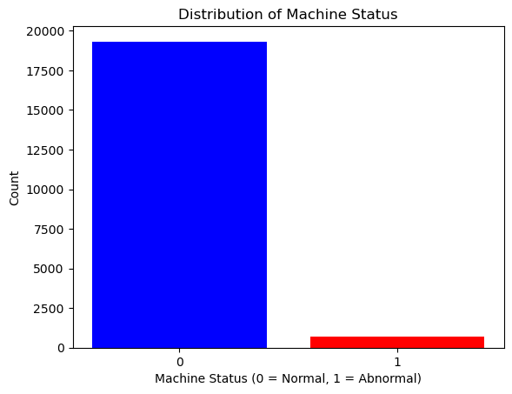
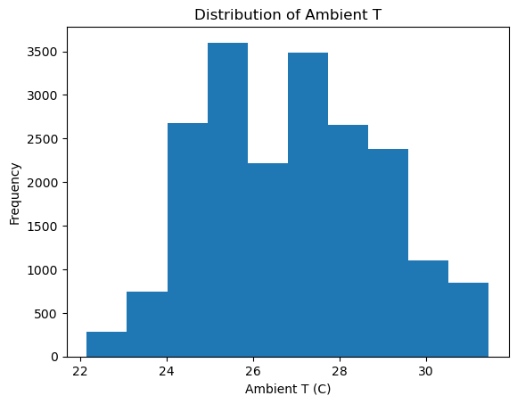
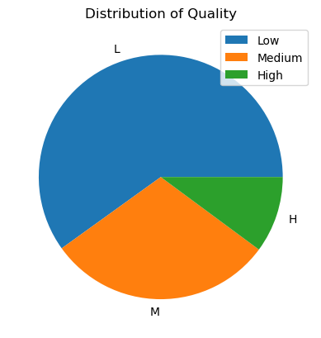
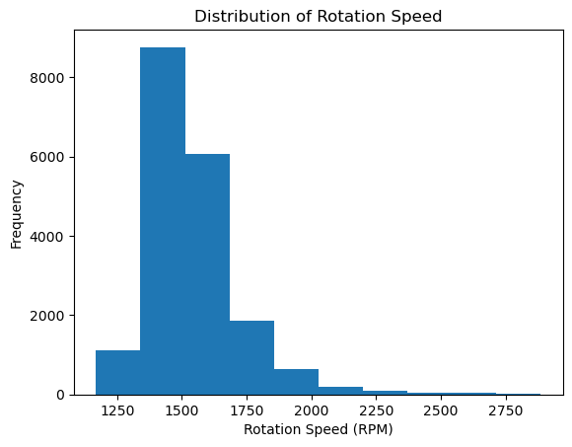
Data Visualisation

Slide 6
Data Cleaning (Imputation)
For Ambient T, I used a SimpleImputer with the strategy “Mean” as there is a gap in the middle, which could be due to the missing data.
For Rotation Speed, I used a SimpleImputer with the strategy “Median” as it is heavily right-skewed but not a clear area which might have been affected by missing data.
For Quality, I used KNNImputer with 5 neighbors as using a SimpleImputer would lead to all the mssing values to be filled with Low Quality.

Slide 7
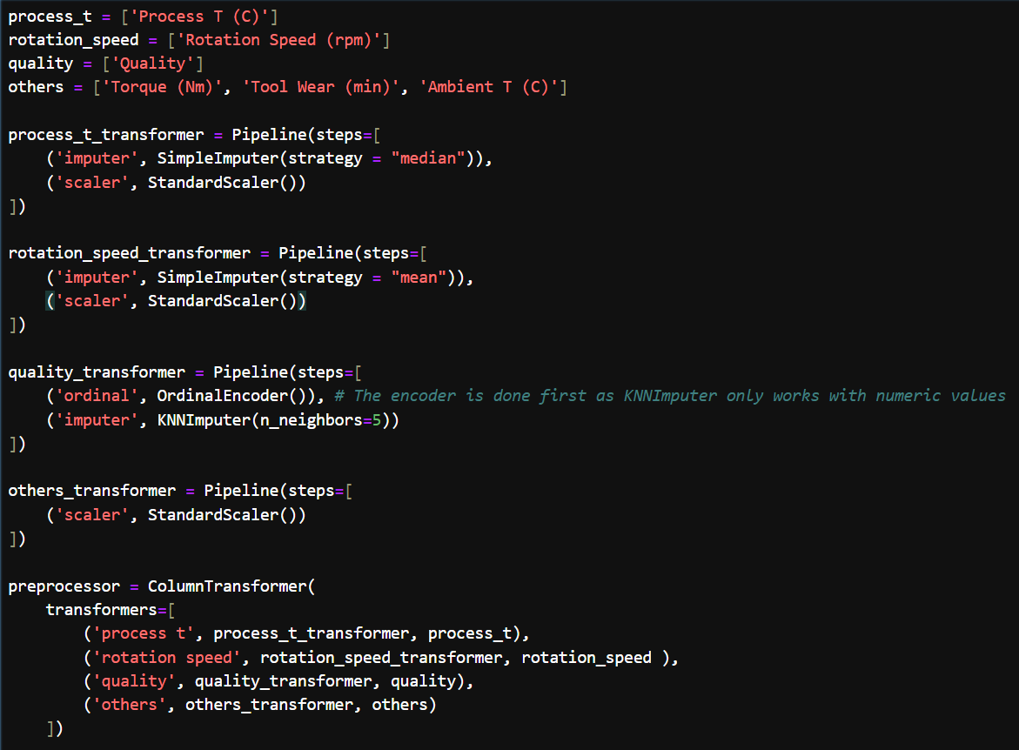
Data Preprocessing
For all the numeric values, I used StandardScaler to standardize them to prevent any single feature from dominating the learning process due to its larger magnitude.
For Quality, I used OrdinalEncoder to convert the categorical values to numeric (L = 0, M = 1, H = 2). This also allows KNNImputer to work as KNNImputer does not work with categorical values.

Slide 8
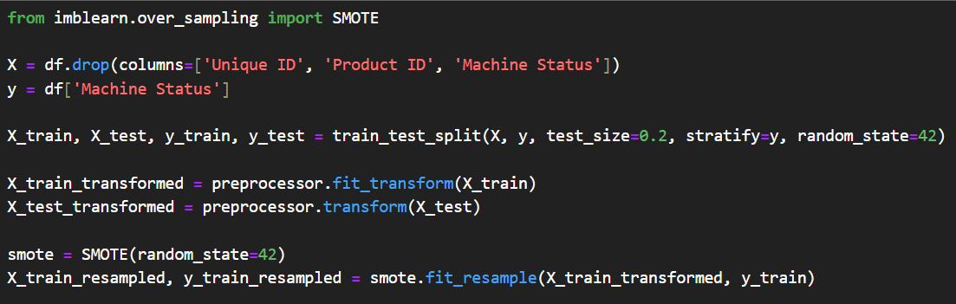
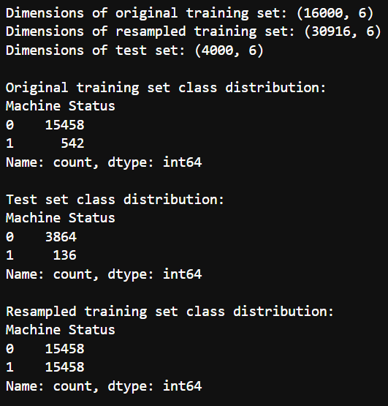
Data Preprocessing
Splitting the dataset and imputing the missing values, I used y_train.value_counts() to see the distribution of the training set and expectedly it showed that it was very imbalanced. So I used SMOTE to generate synthetic samples for the minority class, balancing the dataset.

Slide 9
Model Training and Evaluation
For the models, I chose the ones commonly used and Dummy Classifier as a baseline. From the results, Dummy Regressor is very bad,

Slide 10
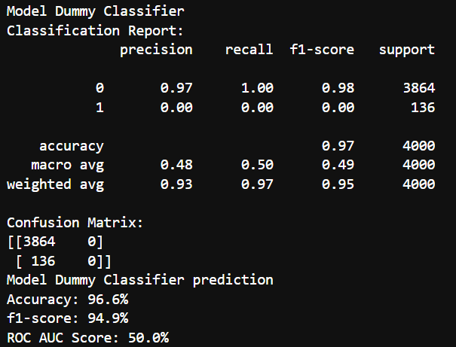
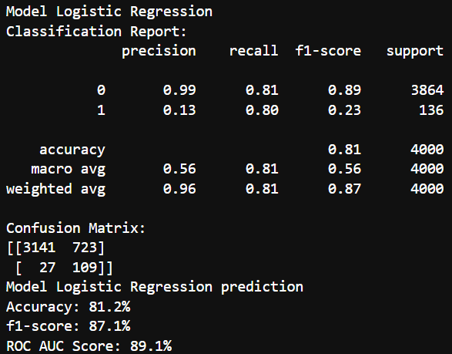
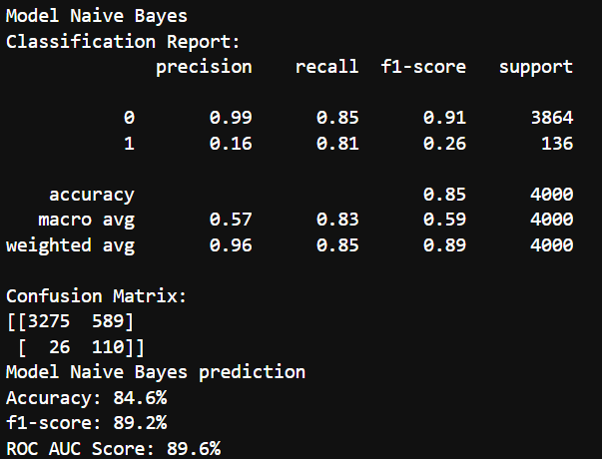
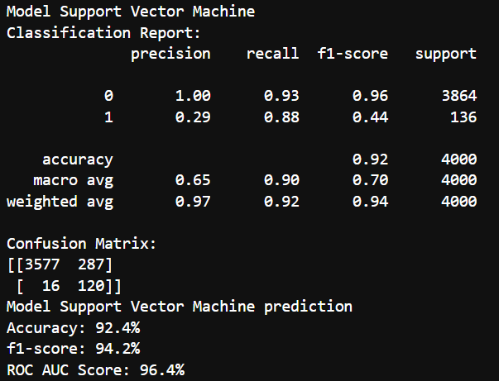
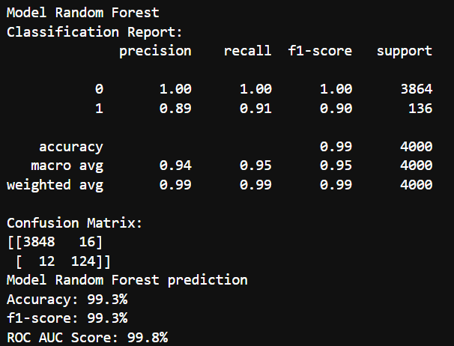
Model Training and Evaluation

Slide 11
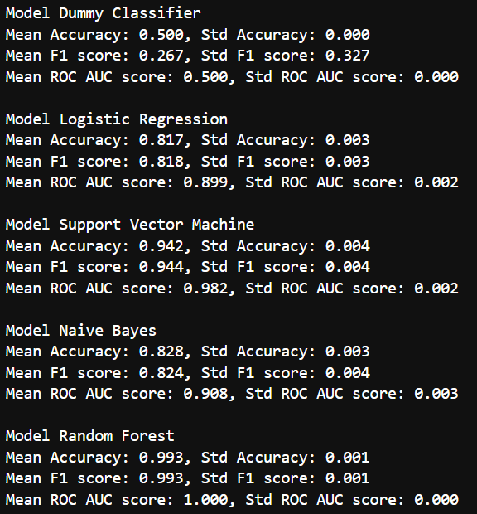
Cross Validation
Using cross validation to ensure that the results were accurate. Cross validation shows similar results and the Dummy Classifier doing poorly.

Slide 12
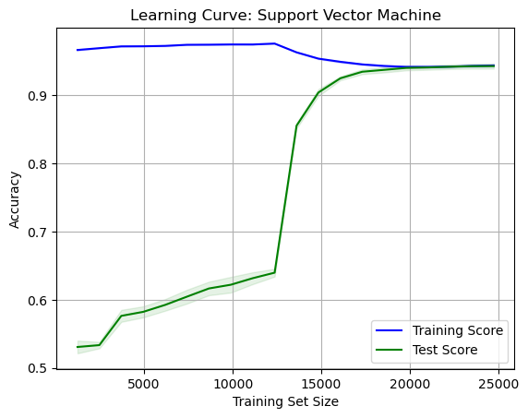
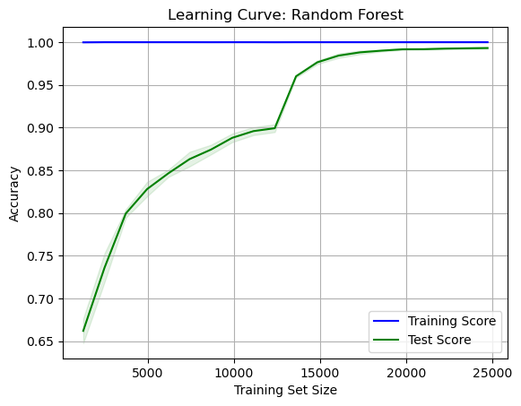
Overfitting Check
Creating a learning curve for the two best models, Support Vector Machine and Random Forest, I am able to check for overfitting. From the results, both are not overfitted, so I will continue using the model with better results, Random Forest.

Slide 13
Hyperparameter Tuning
I chose hyperparameters for Random Forest to try and control model complexity, prevent overfitting, and optimize performance to get a well-balanced model. I also use RandomSearchCV to improve efficiency and speed as using GridSearchCV gave similar results.

Slide 14
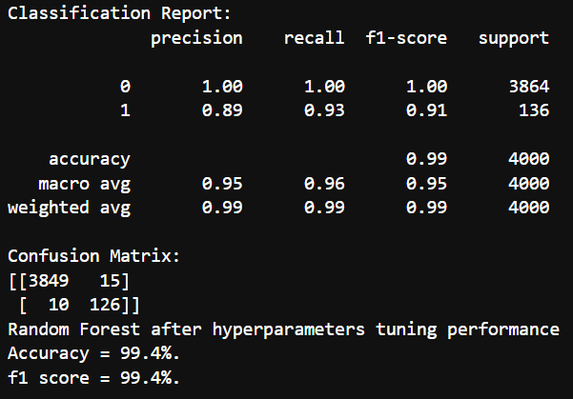
Final Results with Hyperparameter Tuning
From the results, we can see an small improvement in the results, the confusion matrix showing less false positives and false negatives

Slide 15
Conclusion
From making the machine, I have discovered how sometimes, accuracy is not always the best evaluation and might be misinformation, as shown by the Dummy Classifier. I also discovered that based on the features the model finds the most important, sometimes the other features are still relevant, just not for the model.
Overall, the Random Forest model gave a very good result

